Slide 1
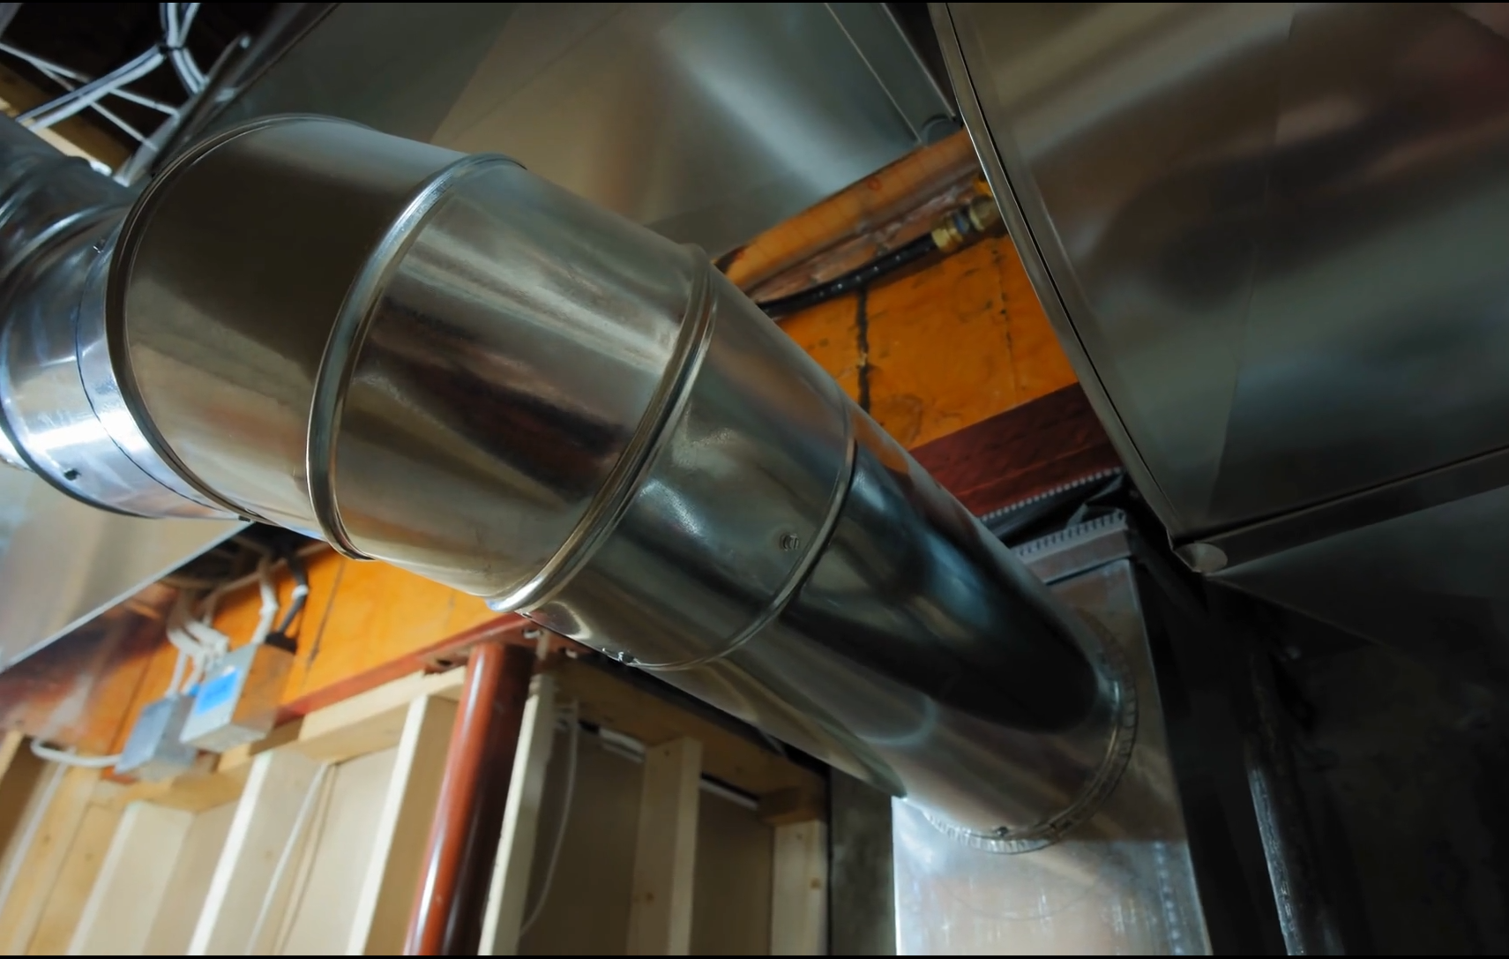
Ducts, Mufflers, and Silencers
Practical considerations
Tyler Dare

Slide 2
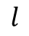
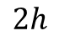
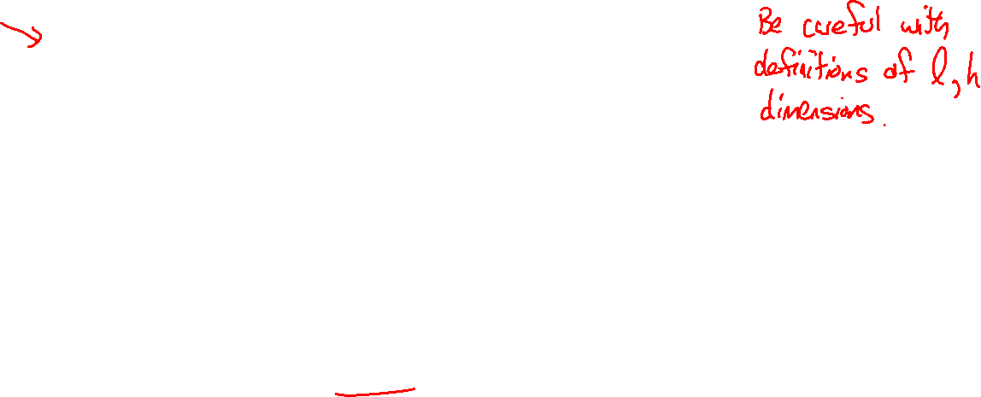
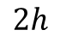
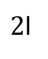
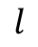
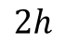
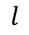
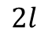
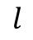
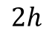
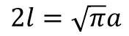
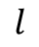
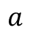
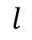
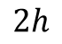
Definitions of geometry and variables
$$2h$$
$$2h$$
$$2h$$
$$l$$
$$2h$$
$$l$$
$$2h$$
$$l$$
$$l$$
$$2l$$
$2$l
$$l$$
$$l$$
$$a$$
$$2l=\sqrt{π}a$$

Slide 3
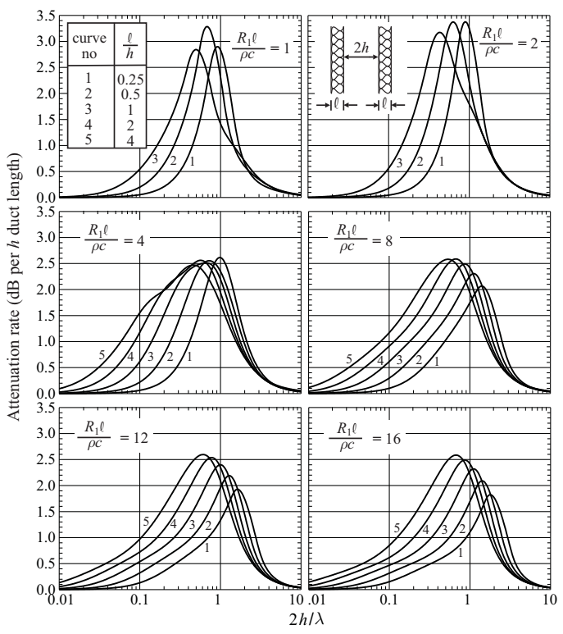
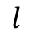
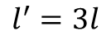
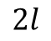
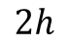
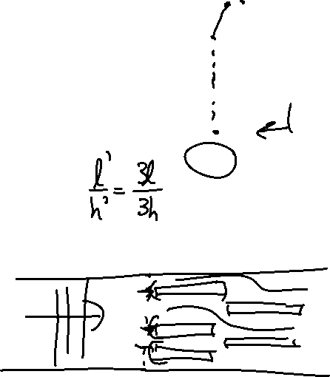
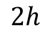
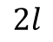
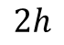
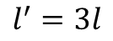
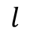
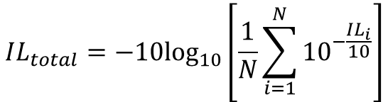
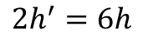
Parallel baffle silencers
$$l$$
$$l^{′}=3l$$
$$2h$$
$$2l$$
$$2h$$
$$2h^{′}=6h$$
$$2l$$
$$2h$$
$$l^{′}=3l$$
$$l$$
The total IL of a parallel baffle silencer is the same as the insertion loss for a single passage if the geometry of all passages are the same and the flow rates of all passages are the same.
$$IL_{total}=−10\log_{10}\left[\frac{1}{N}\sum_{i=1}^{N}{{10}^{−\frac{IL_{i}}{10}}}\right]$$

Slide 4
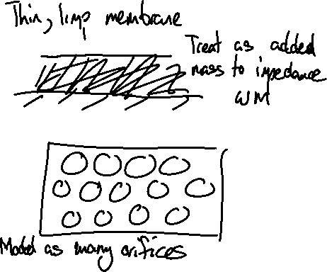
Actual absorbers are more than just fiberglass
Fibrous material
Hard wall
20 gauge perforated facing (>25% open area)
Limp membrane: Plastic sheet, fiberglass cloth, metal mesh
Spacers (wire, etc…)

Slide 5
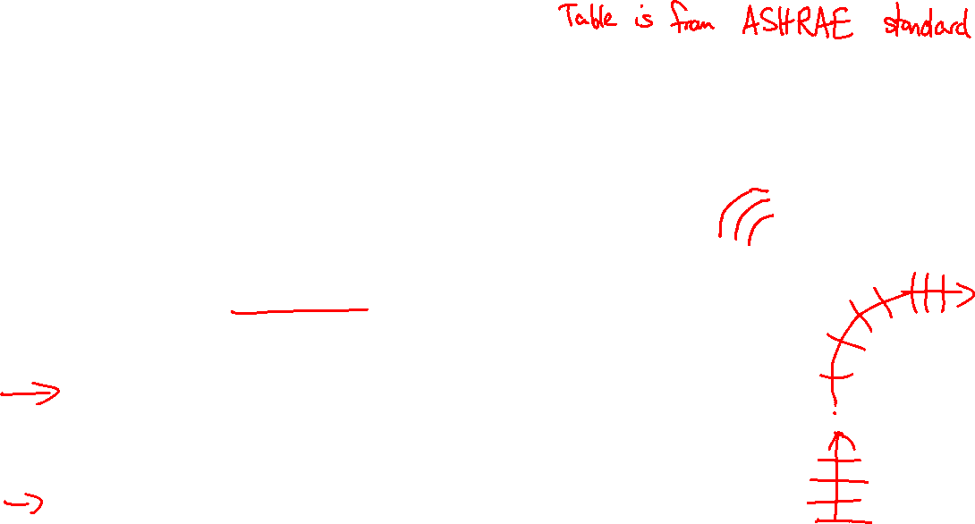
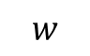
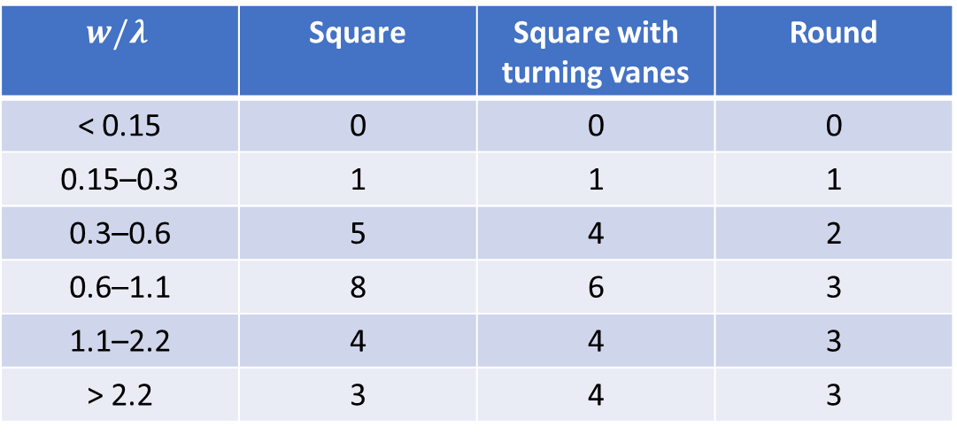
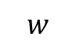
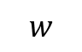
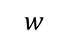
Bends and elbows
Turns will reflect some of the energy back upstream
Most reflection occurs when duct width is comparable to a wavelength
More abrupt elbows reflect more energy
$$w$$
Insertion loss, dB
$$w$$
$$w/λ$$ | Square | Square with turning vanes | Round
< 0.15 | 0 | 0 | 0
0.15–0.3 | 1 | 1 | 1
0.3–0.6 | 5 | 4 | 2
0.6–1.1 | 8 | 6 | 3
1.1–2.2 | 4 | 4 | 3
> 2.2 | 3 | 4 | 3
$$w$$
$$w$$

Slide 6
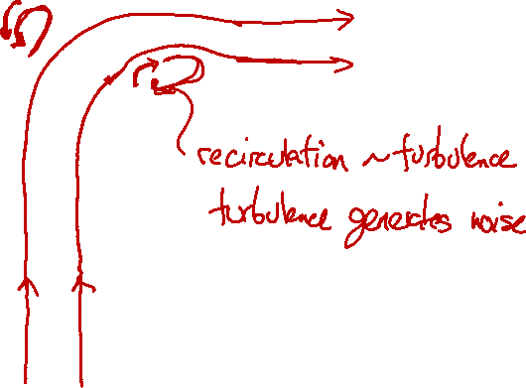
Bends and elbows
With flow, turns can generate self noise.

Slide 7
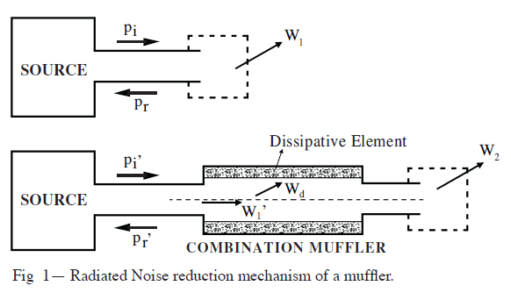
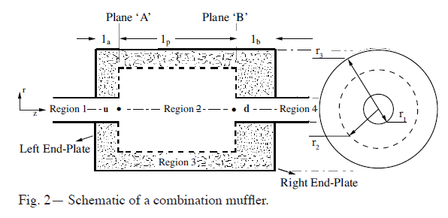
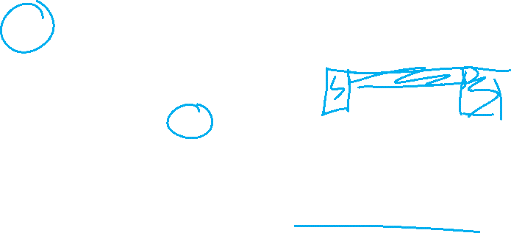
Combination mufflers
Predicting the performance of a muffler with absorbing material can be difficult by hand, but has been modeled.
Source: Panigrahi and Munjal, “Combination Mufflers – Theory and Parametric Study,” Noise Control Engineering Journal, 2005.

Slide 8
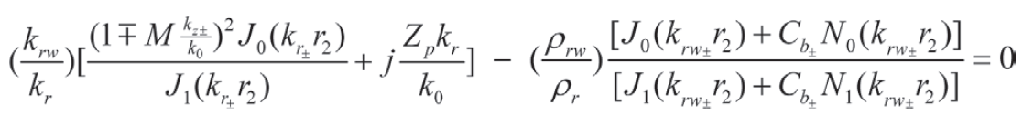
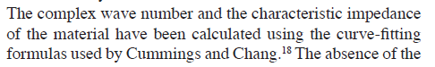
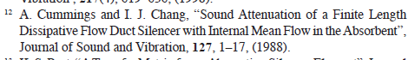
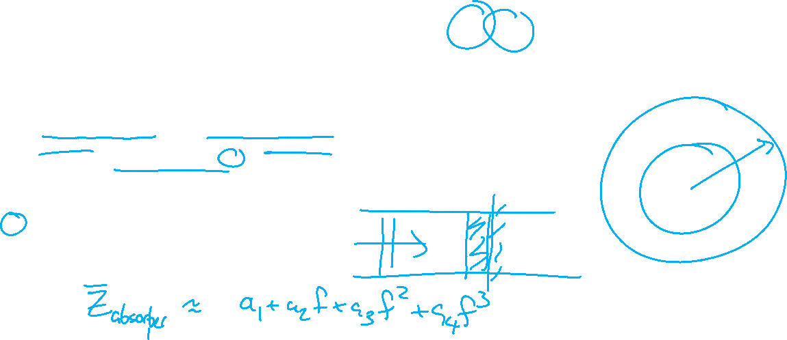
Combination mufflers
Panigrahi and Munjal started with 2D analytical solution

Slide 9
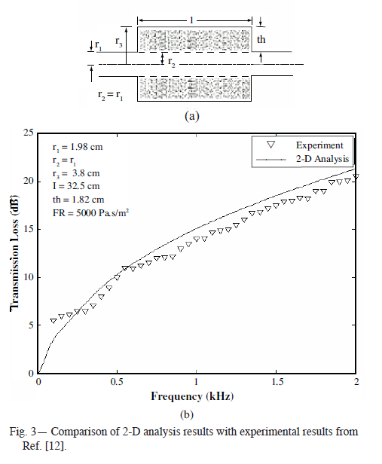
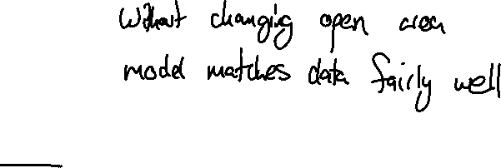
Combination mufflers

Slide 10
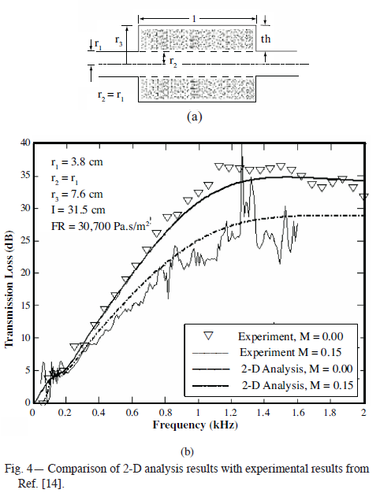
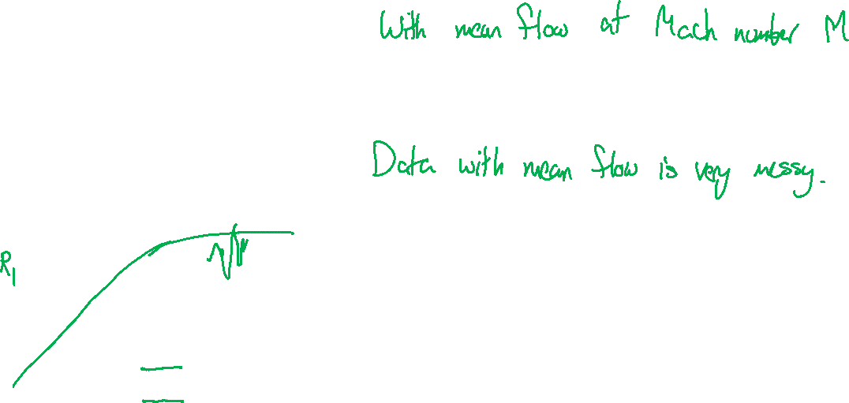
Combination mufflers

Slide 11
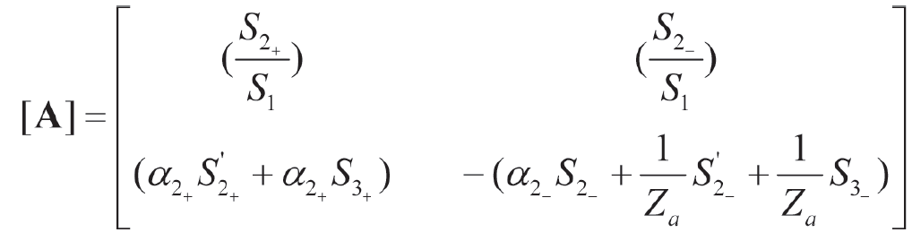



Combination mufflers
Panigrahi and Munjal took 2D solution and computed the 4-pole matrix

Slide 12


Combination mufflers

Slide 13


Combination mufflers

Slide 14


Combination mufflers

Slide 15


Herschel-Quincke tube
Causes destructive interference by allowing side branch to reconnect
$$TL=10\log_{10}\left\{1+\frac{\tan^{2}\left[\frac{k\left(L+0.85d\right)}{2}\right]}{4}\right\}$$

Slide 16




Herschel-Quincke tube

Slide 17


Herschel-Quincke tube

Slide 18


Active control in ducts
Use a source to cause destructive interference

Slide 19


Active control in ducts

Slide 20


Active control in ducts

Slide 21


Active control in ducts

Slide 22


Active control in ducts

